Slide 1
“The IAEA Global Network of Isotopes in Precipitation (GNIP) – Overview”
Stefan Terzer
Isotope Hydrology Section
International Atomic Energy Agency
Vienna, Austria

Slide 2
GNIP objectives
Systematic collection of basic data on isotopic content in precipitation (monthly basis)
on a global scale to determine temporal and spatial variations
of environmental isotopes in precipitation.

Slide 3
GNIP history
Founded 1961, collaboration IAEA-WMO
Focus: Monitoring of thermonuclear fallout
Reduction in 1975, national networks est.
Focus: Isotope Hydrology
Clients from new fields:
Climate change + AGCMs (since 1990s), Ecology, forensics etc. (since 2000s)

Slide 4
Station count timeline

Slide 5
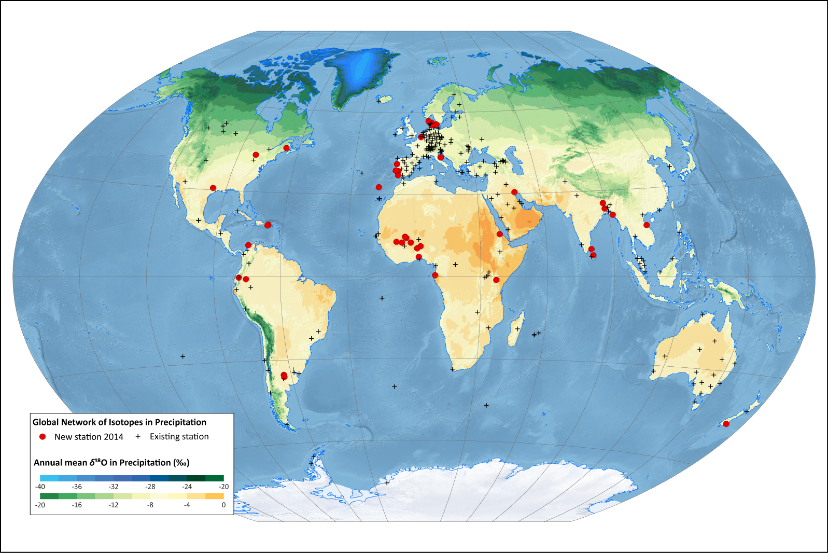
GNIP network coverage (2013)

Slide 6
GNIP sample collection
Representative of local precipitation
Rain gauge siting
Completeness over the year: no gaps, no overflows
Evaporation prevention
During collection
and storage

Slide 7
Collection devices
Standard rain gauge (manual accumulation)
Paraffin oil based totalizer
Submerged-tube totalizer
Table tennis ball totalizer

Slide 8
GNIP structure
Core stations situated in climatically relevant locations
Operated by weather services, analysis @ IAEA
National networks composed of stations operated by national authorities
E.g. Germany, Switzerland, Spain
Affiliated stations which are stations resulting from studies (short-term in nature)

Slide 9
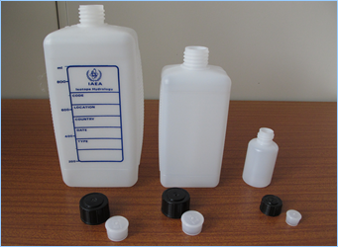
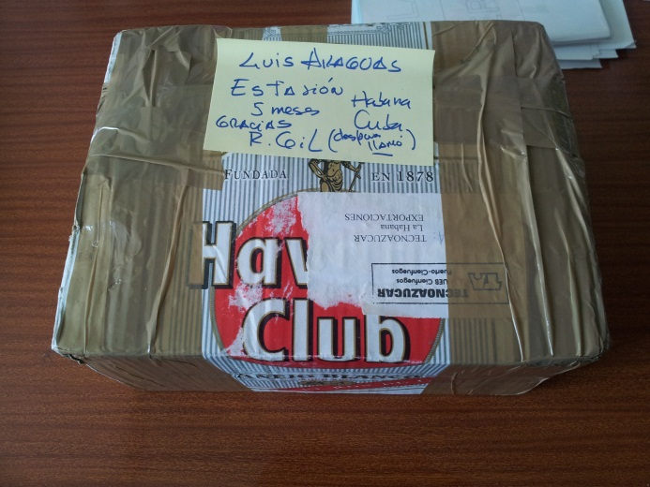
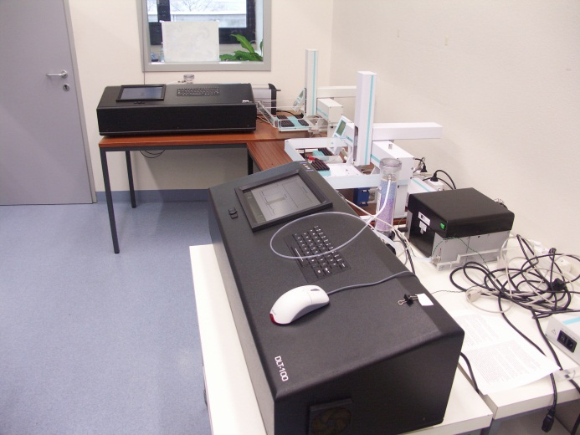
IAEA & GNIP (I)
IAEA support for GNIP stations includes
Provision of bottles and sampling instructions
Samples shipped 1-2x/year
Analytical services, usually @ IAEA-IHL

Slide 10
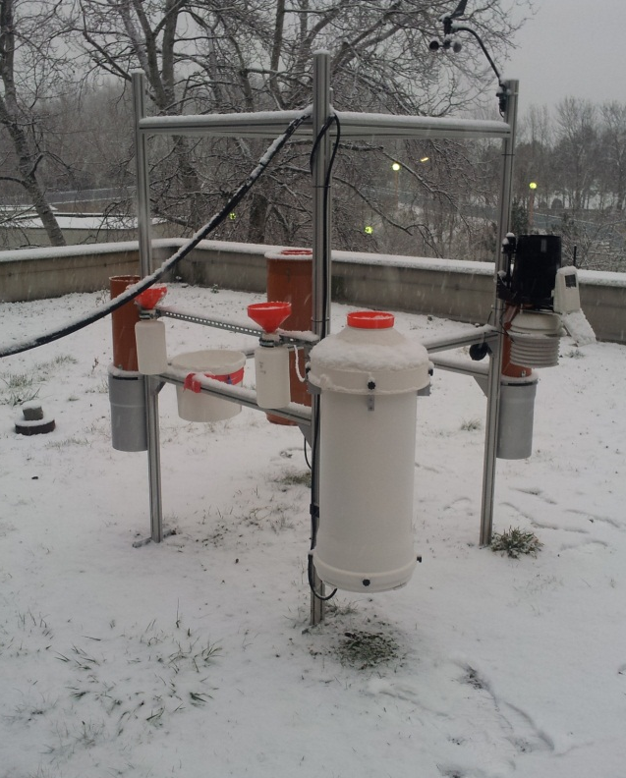
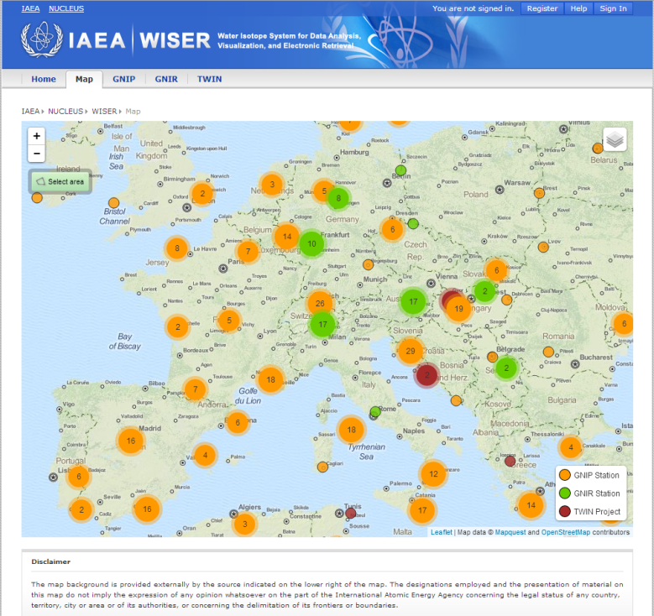
IAEA & GNIP (II)
R&D, Testing, QA/QC
Rain sampling devices
Laser Spectroscopy, Tritium analysis
Interlaboratory comparison
GNIP Database
Data compilation
Dissemination

Slide 11
GNIP data - attributes
Organization by sampling frequency
GNIP – monthly (monthly composite samples)
GNIP – Events (with resolution > monthly)
Parameters recorded
Isotopic composition (δ²H, δ¹⁸O, some also ³H)
Meteorological attributes (precip type, amount, air temperature and vapour pressure)

Slide 12
GNIP known issues (I)
Coverage-related
Uneven spatial coverage of stations
Need for data in remote areas
Partial or incomplete isotope and/or meteorological records
Organizational
Collaboration on voluntary basis
New users and coordination of new contributors

Slide 13
GNIP known issues (II)
Organizational (contd.)
Awareness of weather services
Automatization of weather stations
Sampling/storage protocols compliance
Data QA/QC from externally contributing labs
Data ownership issues

Slide 14
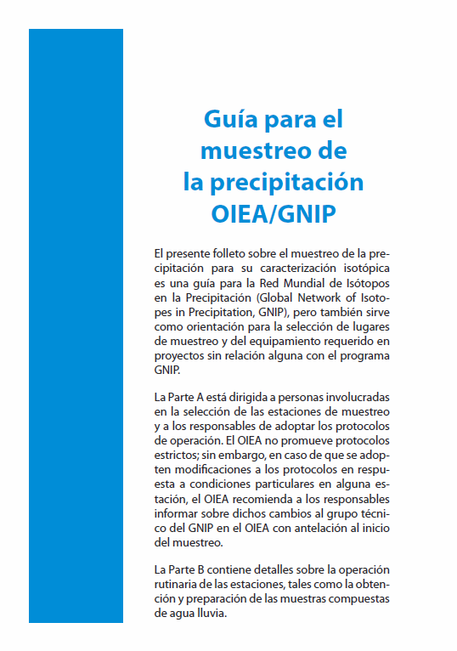
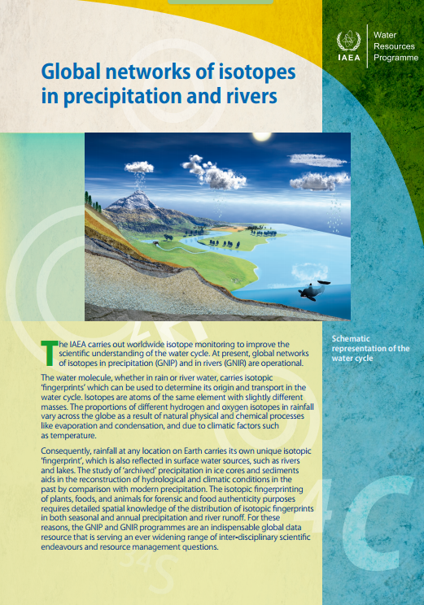
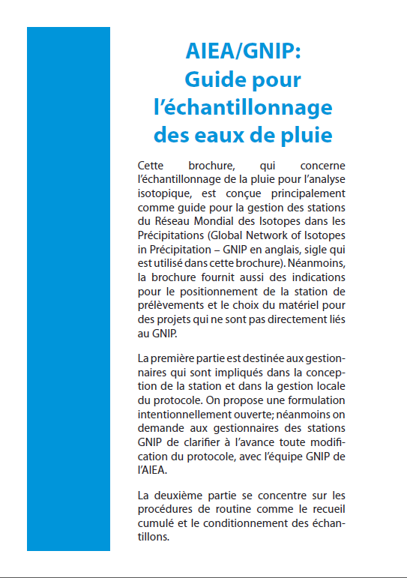
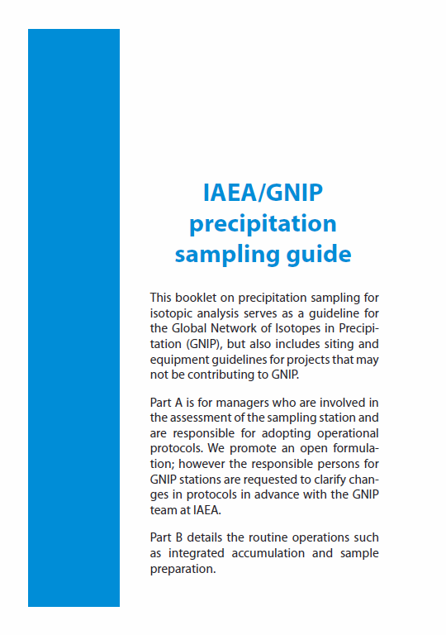
GNIP recent materials

Slide 15
RCWIP - an improved global water isotope pattern prediction model using fuzzy climatic clustering regionalization
S. Terzer, L.I. Wassenaar,
L. Araguas-Araguas and P.K. Aggarwal
Isotope Hydrology Section
International Atomic Energy Agency
Vienna, Austria

Slide 16
Isoscapes
Gridded precipitation δ¹⁸O and δ²H prediction data from GNIP (& related) data
Increasing demand by hydrology, meteorology, climatology, ecology and forensics
1st regression-interpolation model by Bowen et al. (BW, 2002, 2003)
δ¹⁸O = f (Lat², abs(Lat), Alt) + Interpolation

Slide 17
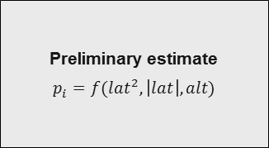
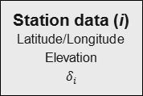
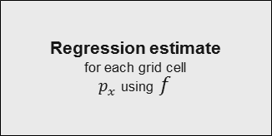
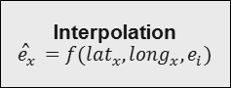
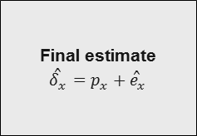
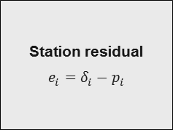
Workflow: BW
Station data (i)
Latitude/Longitude
Elevation
$$δ_{i}$$
Preliminary estimate
$$p_{i}=f({lat}^{2},\left|lat\right|,alt)$$
Station residual
$${e_{i}=δ}_{i}−p_{i}$$
Interpolation
$${\hat{e}}_{x}=f({lat}_{x}, {long}_{x},e_{i})$$
DEM
Latitude/Longitude
Elevation
Regression estimate
for each grid cell
$p_{x}$ using $f$
Final estimate
$${\hat{δ}}_{x}=p_{x}+{\hat{e}}_{x}$$

Slide 18
Regression-Interpolation Models
Global parameterization
Best-suited regressor combination (Bowen 2010)
Vs. regional fitting
Austria (Liebminger et al. 2006)
Mediterranean (Lykoudis & Argiriou 2007)
China (Lui et al. 2008)
Mexico (Wassenaar et al. 2009)
Global coverage but
poorer local predictions
Better fit but
limited domain

Slide 19
RCWIP – bridging the gap
Regionalization: Formation of climatically similar subsets of GNIP stations
Cluster-specific best-fit regressors
For each cluster and month
Summing and weighting
According to membership fractions

Slide 20
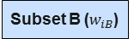
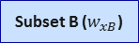
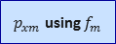
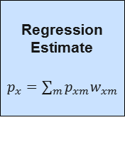
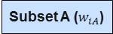
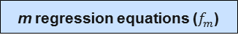
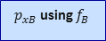
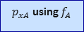
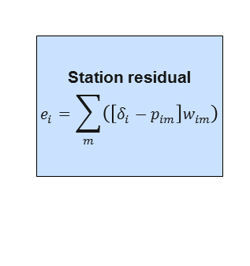

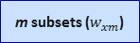

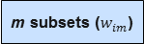
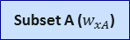
Workflow: BW → RCWIP
Fuzzy
Clustering
Best-fit regr.
choice
Station data (i)
Latitude/Longitude
Elevation
$$δ_{i}$$
Subset A ($w_{iA}$)
$$p_{iA}=f_{A}$$
Preliminary estimate
$$p_{i}=f({lat}^{2},\left|lat\right|,alt)$$
Station residual
$${e_{i}=δ}_{i}−p_{i}$$
Station residual
$$e_{i}=\sum_{m}{\left(\left[δ_{i}−p_{im}\right]w_{im}\right)}$$
Subset B ($w_{iB}$)
$$p_{iB}=f_{B}$$
Climate Data
m subsets ($w_{im}$)
m regression equations ($f_{m}$)
Interpolation
$${\hat{e}}_{x}=f({lat}_{x}, {long}_{x},e_{i})$$
Regression estimate
for each grid cell
$p_{x}$ using $f$
DEM
Latitude/Longitude
Elevation
Subset A ($w_{xA}$)
$p_{xA}$ using $f_{A}$
Regression
Estimate
$p_{x}=\sum_{m}{p_{xm}w_{xm}}$
Final estimate
$${\hat{δ}}_{x}=p_{x}+{\hat{e}}_{x}$$
Subset B ($w_{xB}$)
$p_{xB}$ using $f_{B}$
Gridded Clim. Data
m subsets ($w_{xm}$)
$p_{xm}$ using $f_{m}$
Fuzzy
Clustering
Best-fit regr.
choice

Slide 21
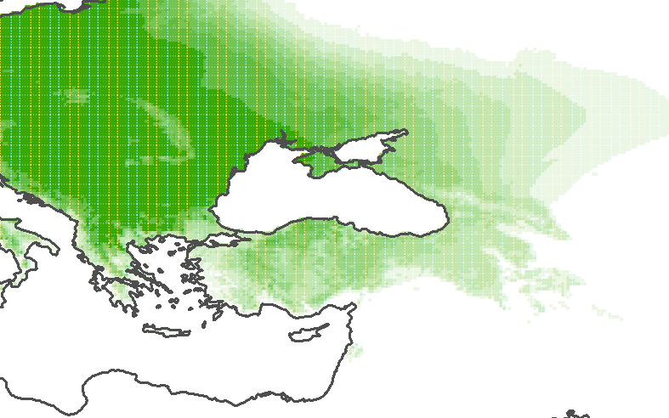
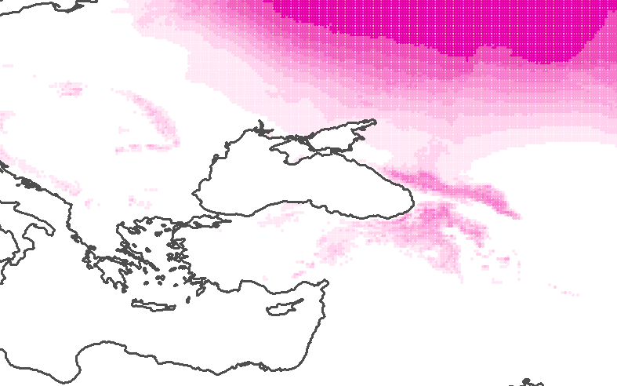
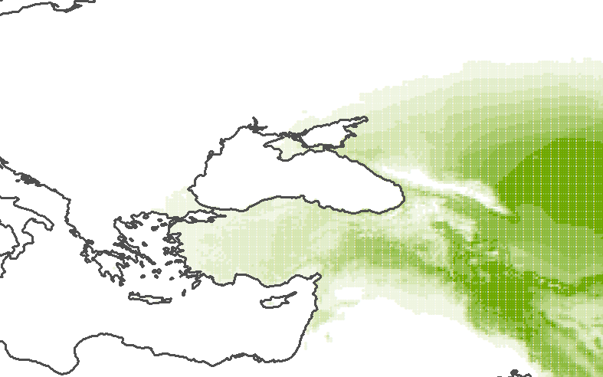
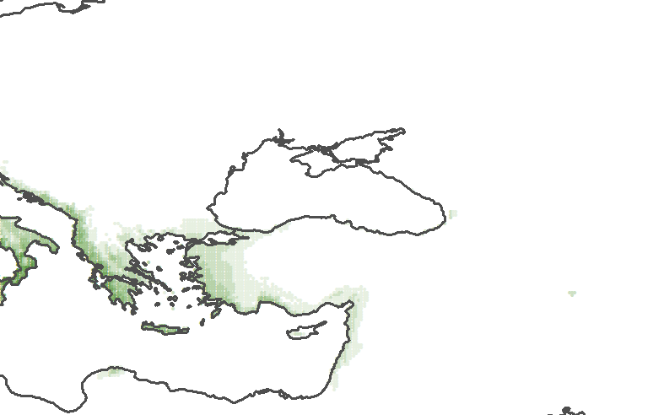
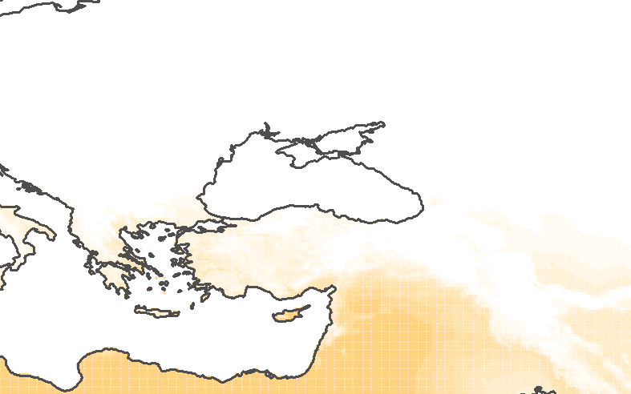
Fuzzy clustering (1)
Fuzzy c-means clustering (Bezdek et al. 1981 etc.) created 36 climatic clusters
No crisp cluster boundaries, membership fractions between 0 and 1
E.g. Athens
Cluster 1
0.14
Cluster 2
0.00
Cluster 4
0.00
Cluster 10
0.34
Cluster 12
0.52

Slide 22
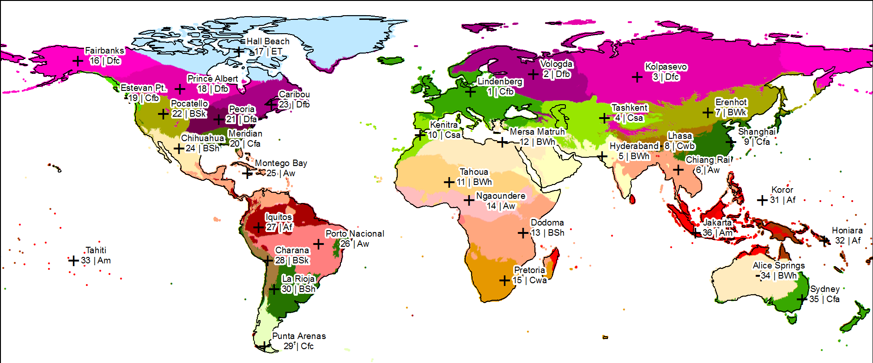
Fuzzy clustering - Results

Slide 23
RCWIM – Regressions
Cluster-specific best-fit regressors
For each cluster and month (also annual)
Possible covariates: Lat, Long, Alt, Precipitation amount, Air temperature, Vapour pressure, precipitable water
Combination obtainng highest R² chosen
If no regression possible, supplemented by global best fit model

Slide 24
Regression results
Lower regression residuals
Improvement of prediction for 67% of stations
RMSE lower for any cluster-month
Example: Cluster 10 („Rabat/Kenitra“)
BW
RCWIM

Slide 25
Kriging (1)
Improved variograms, lowered sills
BW for δ¹⁸O_{ANN}: 4.53 ‰
RCWIM: 1.93 ‰
Result: Lower Kriging error
BW for δ¹⁸O_{ANN}: 1.4 ‰
RCWIM: 1.0 ‰
BW
RCWIM

Slide 26
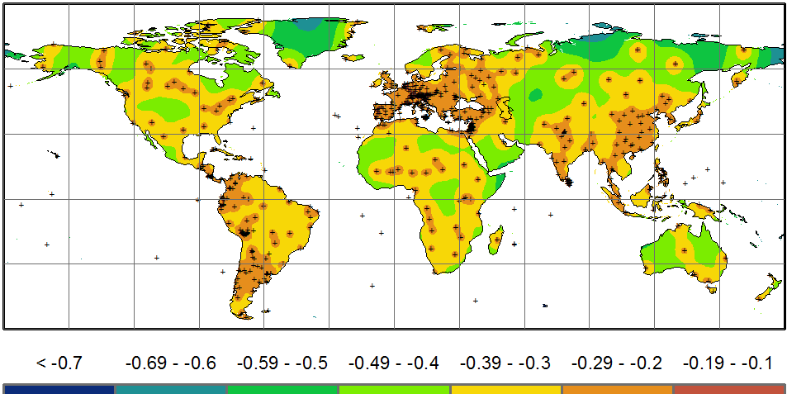
Kriging (2)
Reduction of δ¹⁸O_{ANN} standard error particularly over data-scarce areas

Slide 27
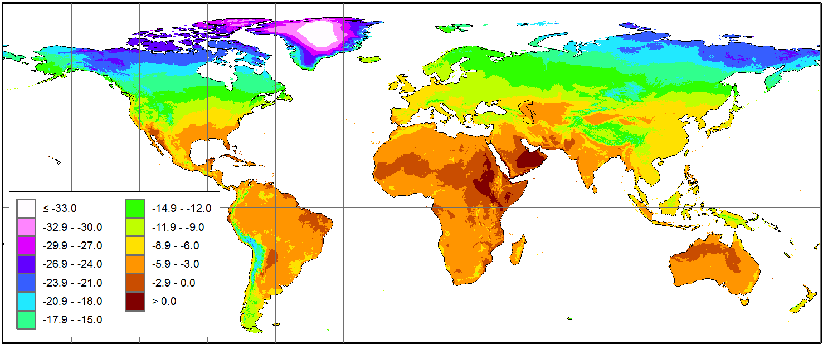
RCWIM Isoscapes – Examples
Predicted Global annual amount weighted δ¹⁸O

Slide 28
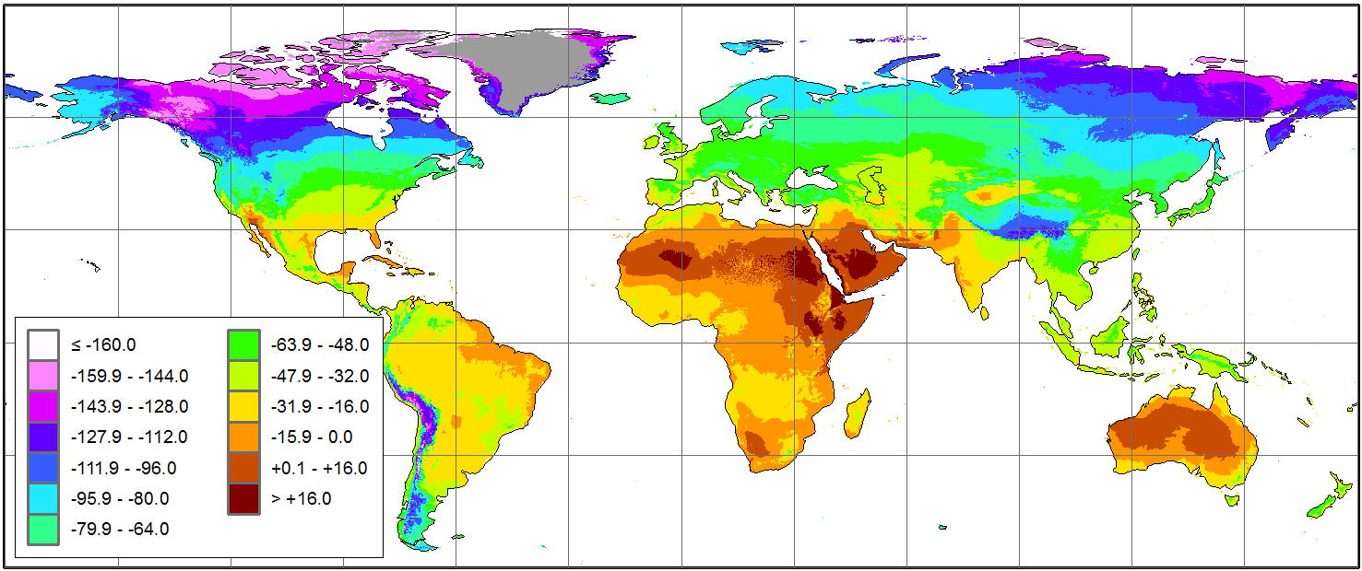
RCWIM Isoscapes – examples
Predicted Growing Season amount weighted δ²H

Slide 29
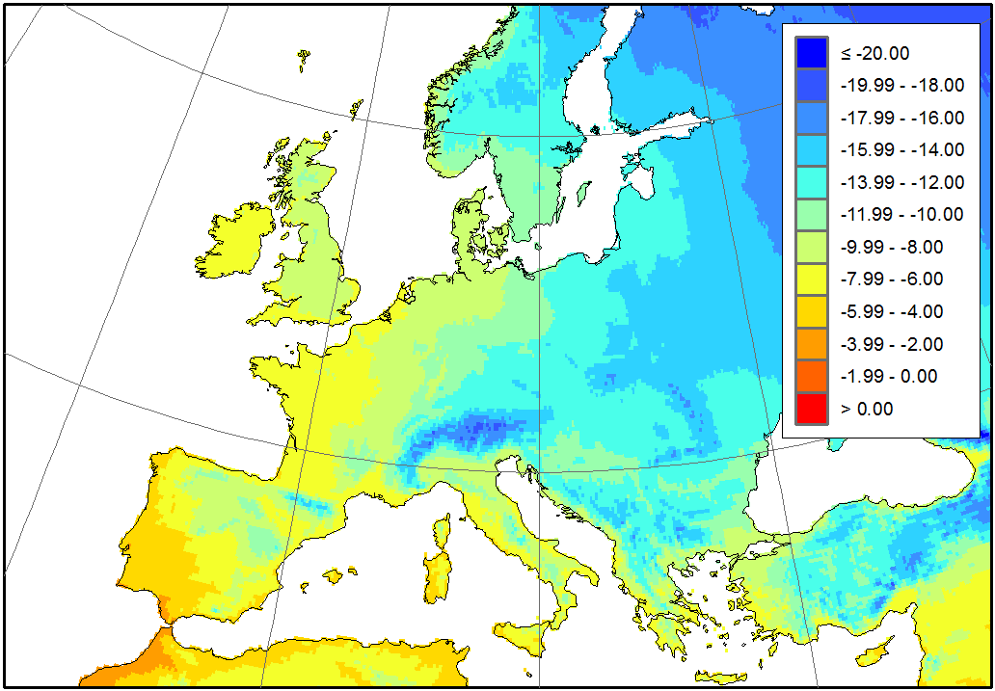
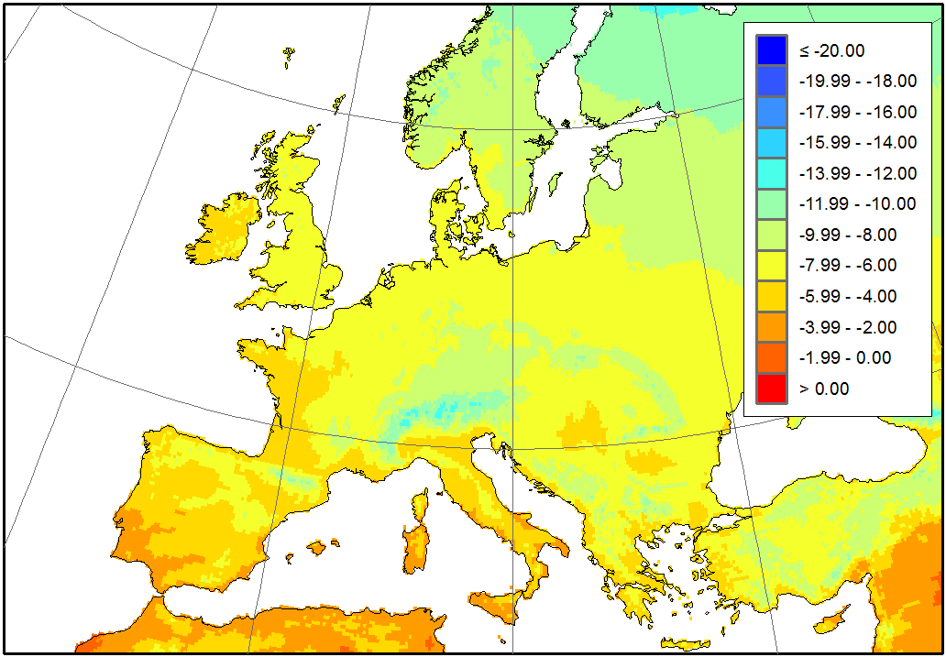
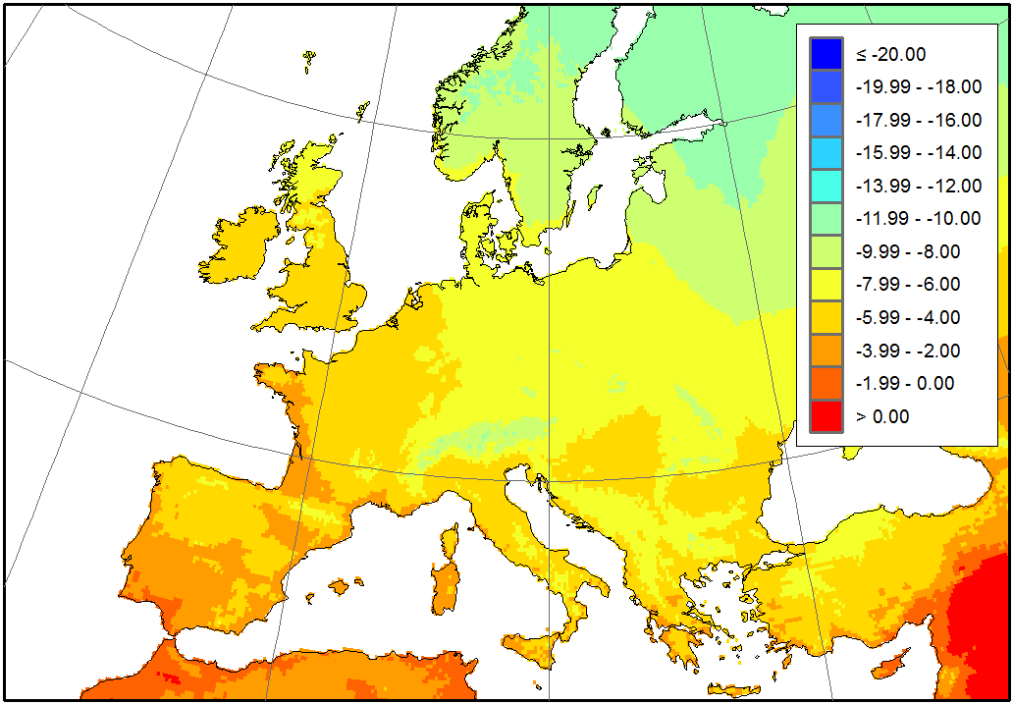
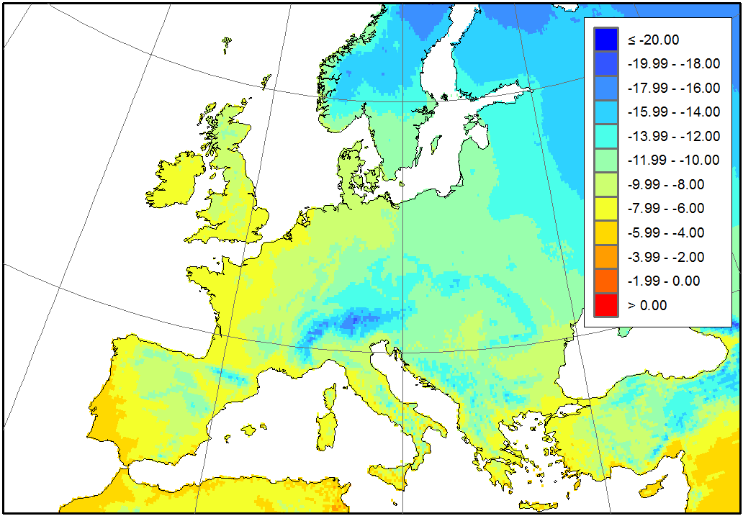
Isoscapes – Seasonal Predictions
Feb
May
Aug
Nov
Seasonal δ¹⁸O

Slide 30
Conclusion
Combination of regionally specific regression models + residual interpolation to predict monthly and annual δ¹⁸O and δ²H.
Spatial Analysis used to predict mean δ¹⁸O for upstream catchment area of a point along the river

Slide 31
Thanks for your attention!
Check for updates:
http://www.iaea.org/water

